Slide 1
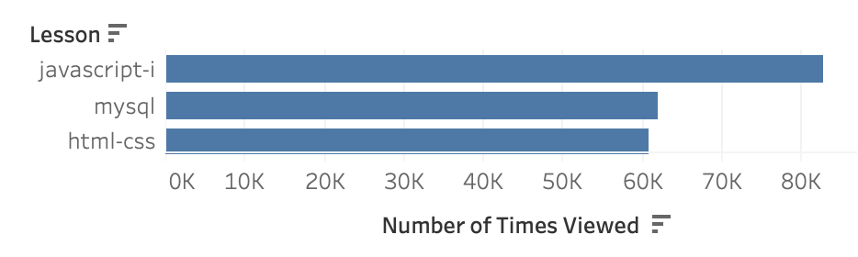
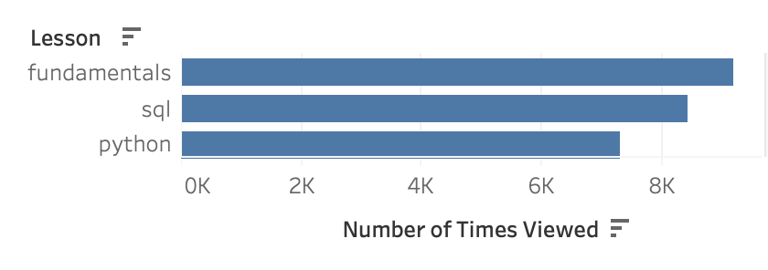
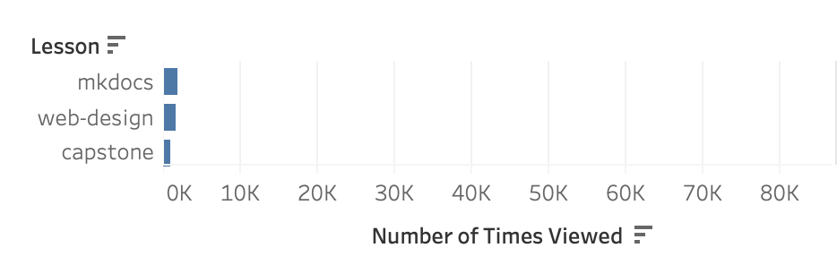
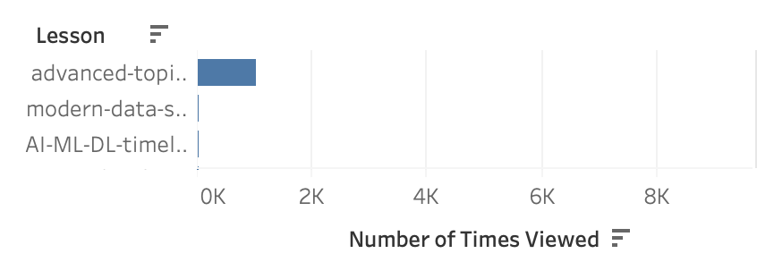
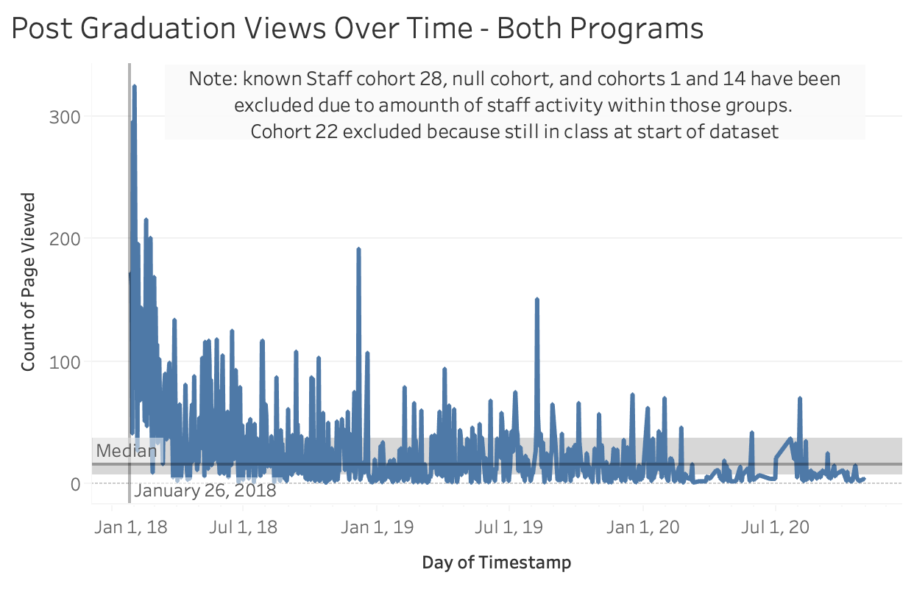
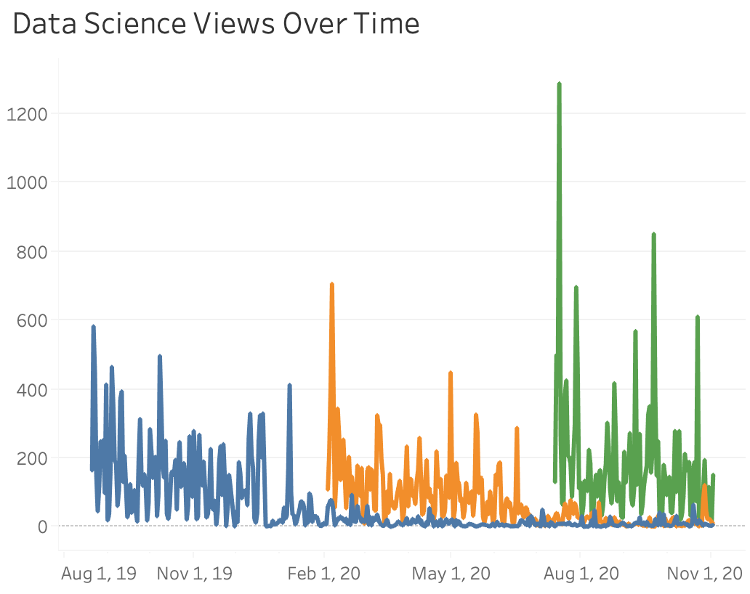
Web Development
Data Science
Most Traffic
Most Traffic
Least Traffic
Least Traffic
Notes:
1. Which lesson appears to attract the most traffic consistently across cohorts (per program)?
WebDev = Javascript-i (75K), mysql and html-css (both around 55K)
DataSci = Fundamentals, SQL, Python
2. Is there a cohort that referred to a lesson significantly more that other cohorts seemed to gloss over?
WebDev: Cohorts 23, 24, 25, 29, 31 used Slides and not Web Design, Cohort 32 on used Web Design not slides
DataSci: Bayes and Curie used Regression more frequently than Classification, which Darden used Classification far more than Regression. This is likely because the first big project for Darden was in Classification while in the other 2 cohorts the first big project was in Regression
3. Are there students who, when active, hardly access the curriculum? If so, what information do you have about these students?
Data inaccuracy casts doubt on effectiveness of looking at this metric
If average page_viewed per user_id is under the 25th percentile inaccuracies in user_id assignment and dropped students should be investigated before determining that there are just some student who access the curriculum less overall
There are user_id that are substantially below the mean, but investigation into Darden showed this can be a result of duplicate ids being assigned halfway through class or students who drop from class (there are 4 students in Darden with 2 different IDs)
Overall Population mean and percentiles (note: this is NOT filtered down to only during cohort in session time)
- Average Accesses per user_id (for full date range in dataset)
- mean: 659
- 25th percentile: 133
- 50th percentile: 728
- 75th percentile: 1637
4. Is there any suspicious activity, such as users/machines/etc accessing the curriculum who shouldn’t be? Does it appear that any web-scraping is happening? Are there any suspicious IP addresses? Any odd user-agents?
- unable to find oddities without reasonable explanation
- large usage past grad date for cohort 1 and 14 turned out to be Codeup IP addresses
- other IP with multiple users appear to be telecom companies masking user IP
- as expected most cohorts stop accessing after graduation except for a few users
- more recently graduated cohorts continue to access, particularly during job search and early placement
5. At some point in the last year, ability for students and alumni to cross-access curriculum (web dev to ds, ds to web dev) should have been shut off. Do you see any evidence of that happening? Did it happen before?
Bayes and Curie from Data Science both had isolated users who accessed the Java-i and/or Java-ii lessons
There has been no access from Darden of the WebDeb curriculum
There is a user in Bash who is accessing the Data Science curriculum as recently as 11/1/2020, this indicated access has not been turned off from WebDev to Data Science
There have been other accesses to the Data Science curriculum by WebDev users in both 2019 and 2020, but only 1 user recently
6. What topics are grads continuing to reference after graduation and into their jobs (for each program)?
Data Science most common lesson post graduation = SQL
WebDev = Javascript-i (almost 20K), spring and html-css (both at 15K)
7. Which lessons are least accessed?
Of the commonly accessed lessons (not including lessons with less than 1% of views which are likely no longer in use):
WebDeb = slides, web design, content
DataSci = Advanced Topic, Distributed-ML
8. Anything else I should be aware of?
Here is the link to my Tableau public profile for the charts above and additional charts.
NOTE: accesses to home page only ("/") have been filtered out
I did not investigate null cohort values, they are all assigned to Cohort 0 in my Jupyter Notebook

